Slide 1
109 Data Structure Quiz-1
助教:蔡秉翰

Slide 2
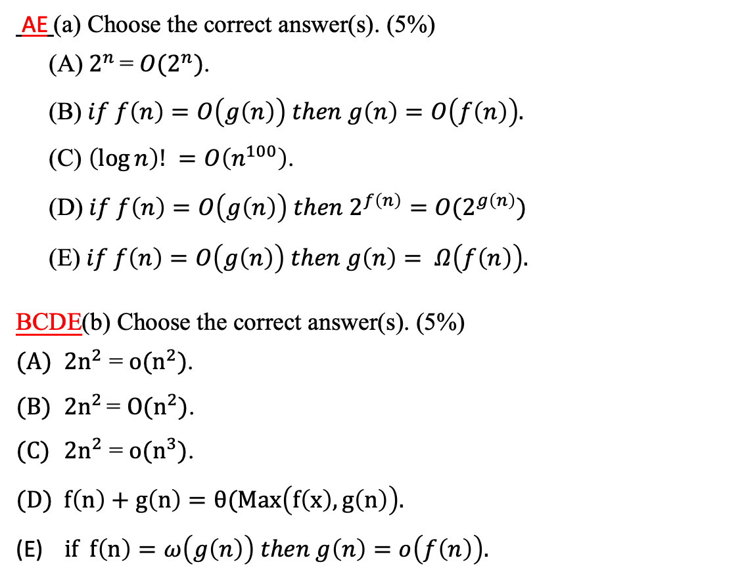
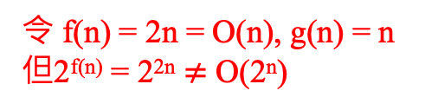
1.
AE (a) Choose the correct answer(s). (5%)
(A)$2^{n}$ = $O(2^{n})$.
(B)$if f\left(n\right)=O\left(g\left(n\right)\right) then g\left(n\right)=O\left(f\left(n\right)\right).$
(C) $\left(\log{n}\right)! =O\left(n^{100}\right)$.
(D)$if f\left(n\right)=O\left(g\left(n\right)\right) then 2^{f\left(n\right)}=O(2^{g\left(n\right)})$
(E)$if f\left(n\right)=O\left(g\left(n\right)\right) then g\left(n\right)= Ω\left(f\left(n\right)\right).$
BCDE(b) Choose the correct answer(s). (5%)
$2n^{2}$ = $o(n^{2})$.
${2n}^{2}$ = $O(n^{2})$.
$2n^{2}$ = $o(n^{3})$.
$f\left(n\right)+g\left(n\right)=θ(Max\left(f\left(x\right),g\left(n\right)\right).$
$if f\left(n\right)=ω\left(g\left(n\right)\right) then g\left(n\right)=o\left(f\left(n\right)\right).$
If f(n) = 2n, g(n) = n² => g(n) $≠O\left(n\right)$
(log n)! 取log = O(logn(loglogn)), n¹⁰⁰ 取 log = O(logn)
因為 O(logn(loglogn)) > O(logn) 所以 (log n)! > n¹⁰⁰
令 f(n) = 2n = O(n), g(n) = n 但2^{f(n)} = 2^{2n} $≠$ O(2^{n})
取c=1 or 2不滿足
正常來說時間複雜度不會有負係數存在
因題目沒有定義清楚，故送分

Slide 3
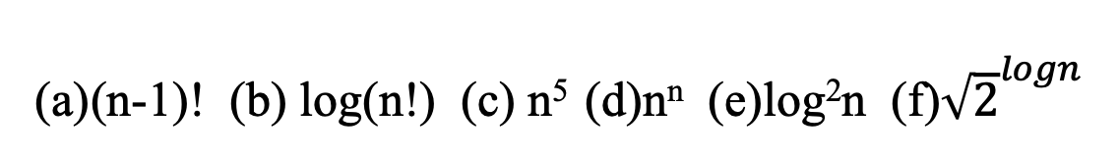
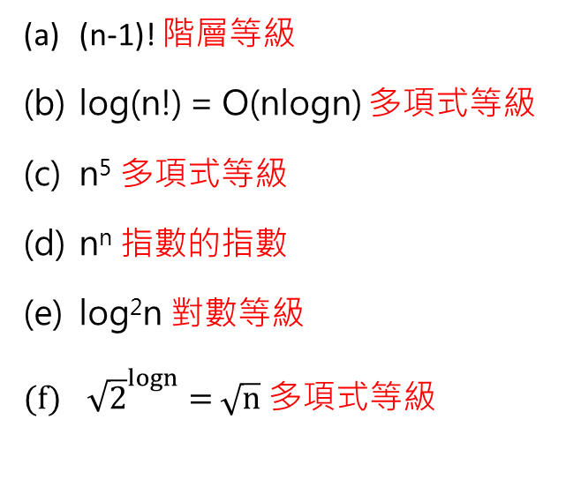
2.
(n-1)! (b) log(n!) (c) n⁵ (d)n^{n} (e)log²n (f)${\sqrt{2}}^{logn}$
(n-1)! 階層等級
log(n!) = O(nlogn) 多項式等級
n⁵ 多項式等級
n^{n} 指數的指數
log²n 對數等級
${\sqrt{2}}^{logn}=$ $\sqrt{n}$ 多項式等級
常數<對數<多項式<指數<階層<指數的指數
e < f < b < c < a < d

Slide 4
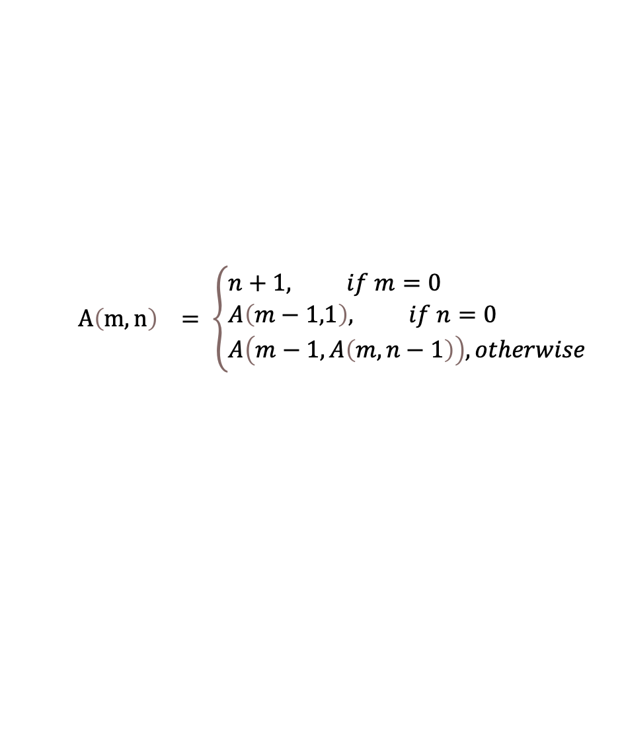
3. There is a function defined as follows.
(a) Write a recursive function in C. (2%)
$$A\left(m,n\right) = \left\{\begin{aligned}&n+1, if m=0 \\ &A\left(m−1,1\right), if n=0 \\ &A\left(m−1, A\left(m,n−1\right)\right), otherwise\end{aligned}\right.$$
int ak(int m, int n){
if(m == 0) return n+1;
else if (n == 0) return ak(m-1,1);
else return ak(m-1,ak(m,n-1));
}
(b) A(3,2)= ? (3%)
Ans: 29
(c) How many times will it call the function ak() when m = 2, n = 4? (includes the first time) (5%)
Ans: 65

Slide 5
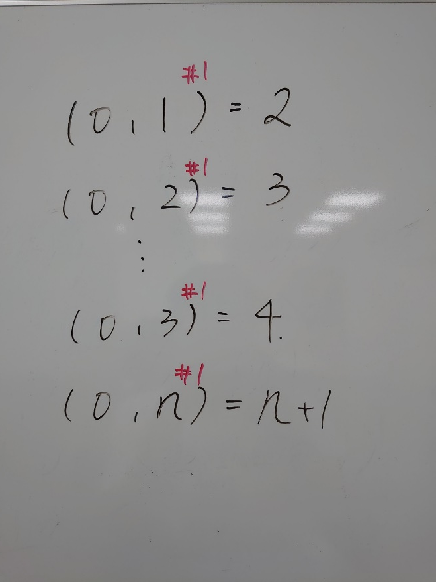
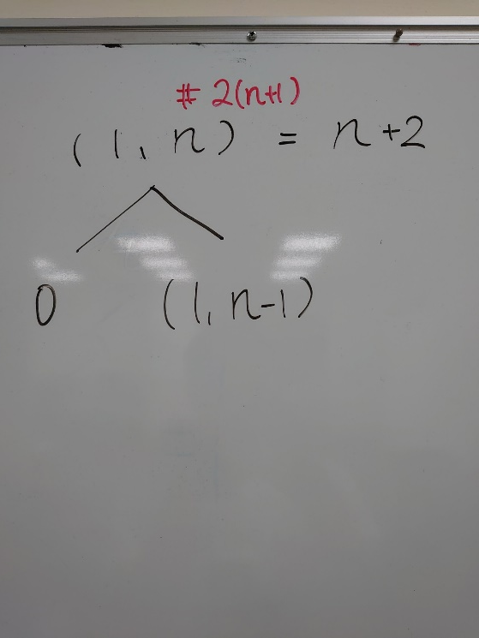
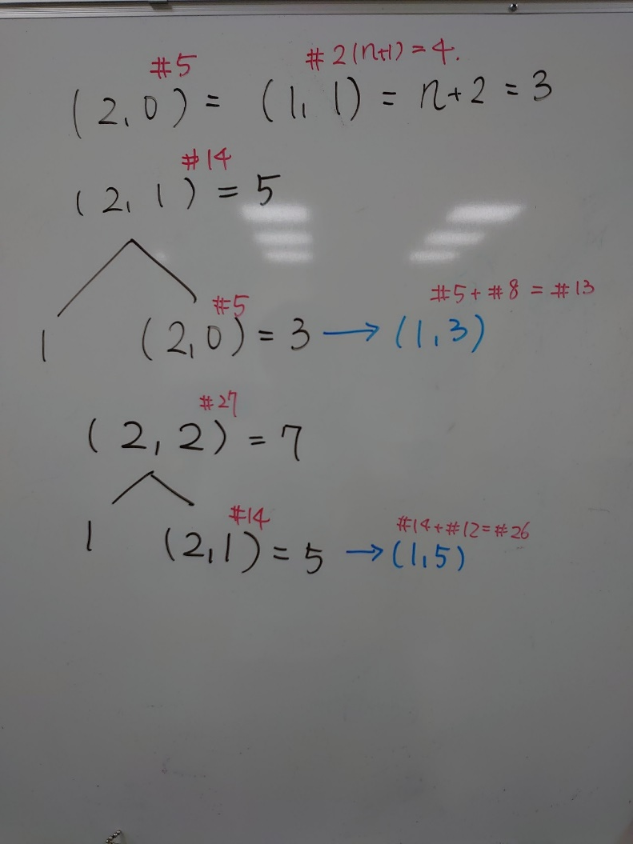
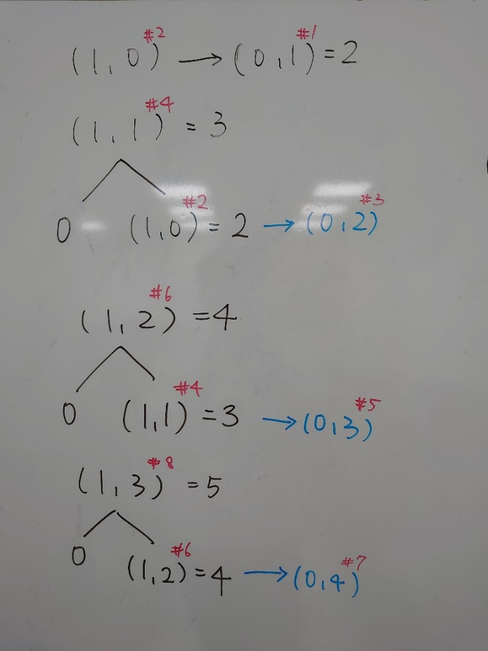
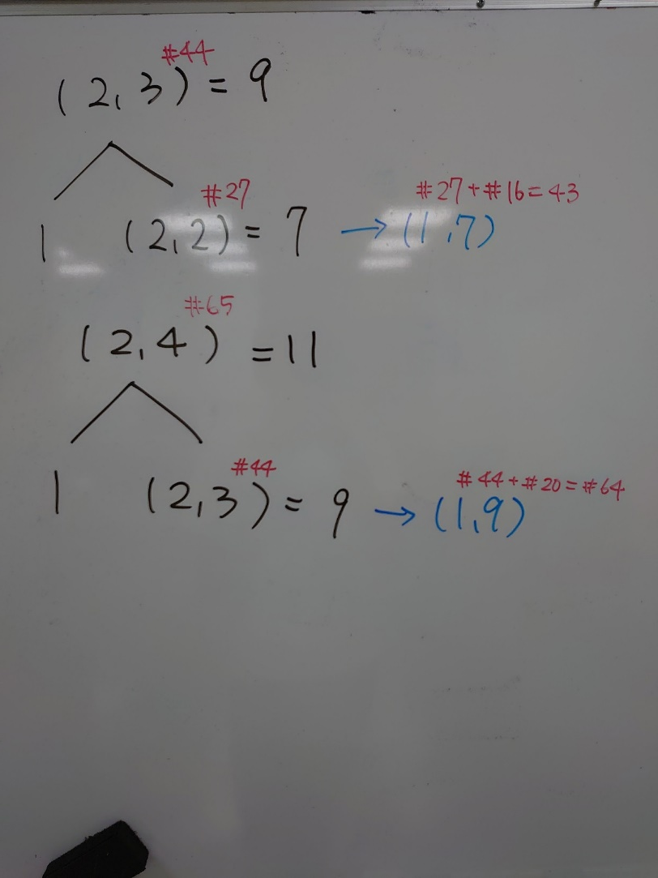
3.

Slide 6
4.
Use 3-tuple represent the matrix A. (3%)
Use the answer of (4.a) to find a transpose matrix. (3%)
5 | 3 | 6
0 | 0 | 2
2 | 1 | 3
2 | 2 | 1
3 | 0 | 8
3 | 2 | 7
4 | 1 | 5
3 | 5 | 6
0 | 0 | 2
0 | 3 | 8
1 | 2 | 3
1 | 4 | 5
2 | 2 | 1
2 | 3 | 7
F (c) Does using 3-tuple save more space? (Answer True or False) (4%)
沒說明清楚In this case 故送分
原表達式:3*5=15
3-tuple:3*7=21

Slide 7
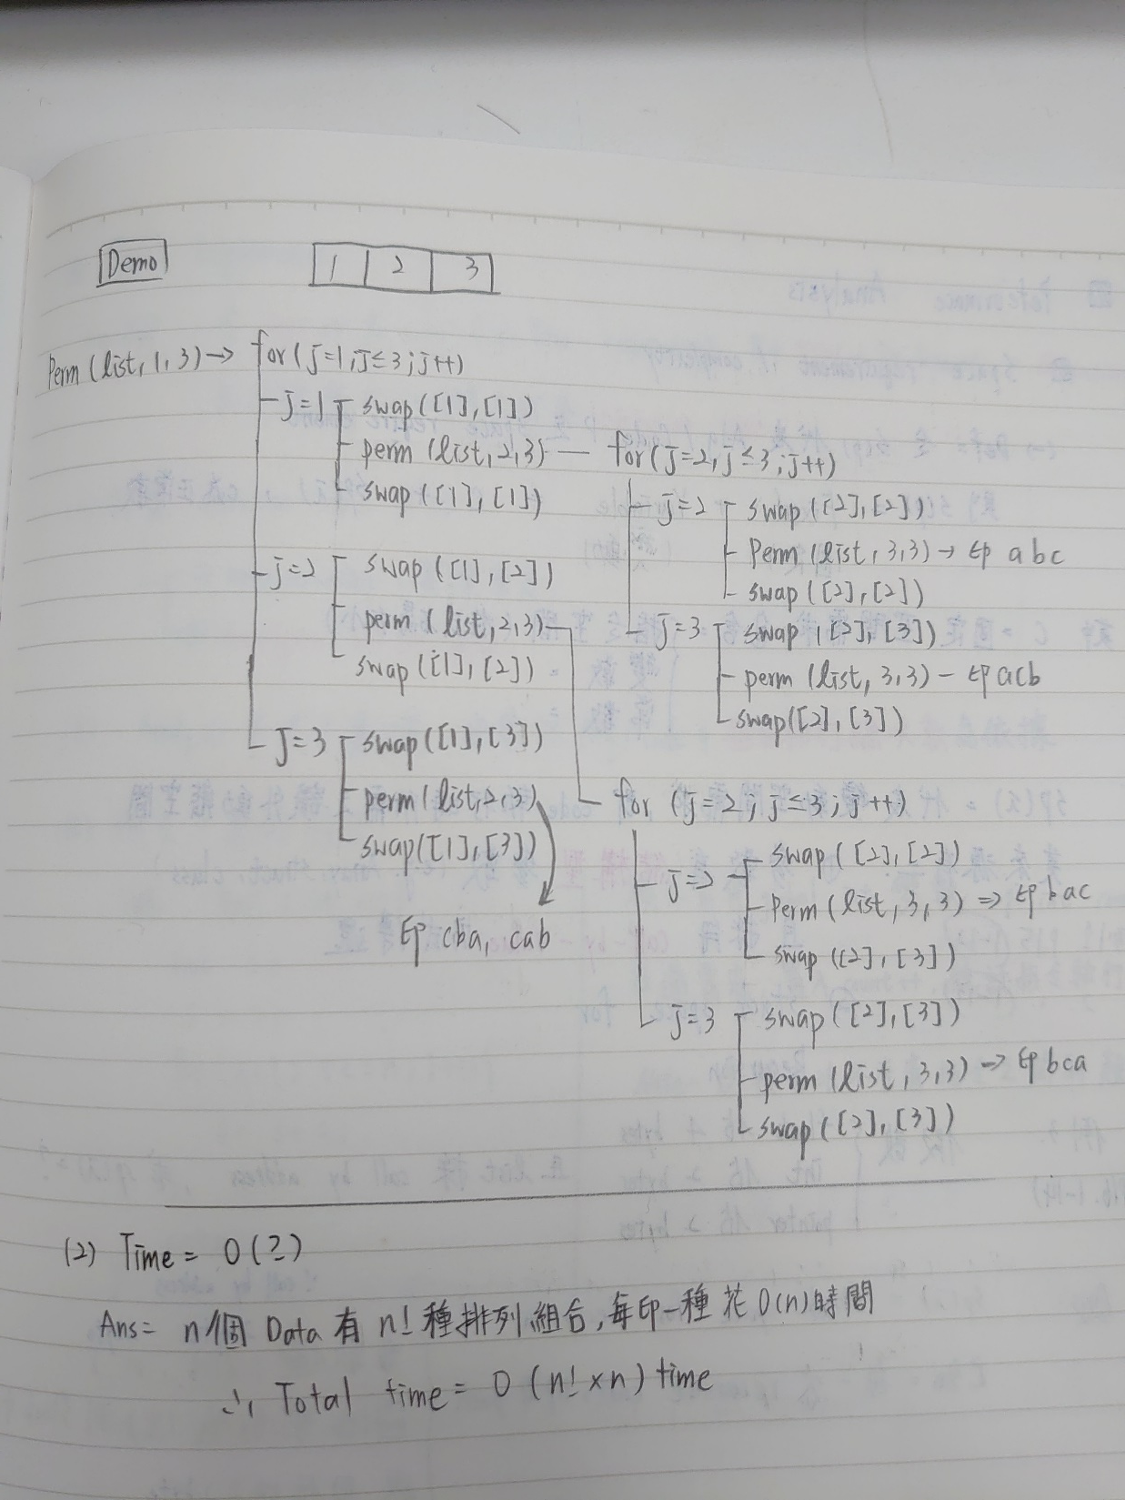
5. Given a set of n elements (n≥1), function P will print out all possible permutations of this set.
For example, the permutations of {a, b, c} are
{ (a, b, c), (a, c, b), (b, a, c), (b, c, a), (c, a, b), (c, b, a) }
void P(char* list, int i){
size_t length = strlen(list); //get the size of list
if(i == length){
for(int i = 0;i<length;i++) printf(“%c”, list[j]);
printf(“\n”);
}
else{
for(j=i; j< (a) (2%) ; j++){
swap( list[i] , list[j]); // The swap function will exchange the element of parameter.
P( (b) (3%) );
swap( list[i] , list[j]);
}
}
}
void main(){
// Assume list has been initialized and the size of list is n.
P(&list,0);
}
The time complexity of this algorithm is: (c) (5%) .
Please finish the function.
Ans: (a) n (b) P(list,i+1) (c) O(n*(n!))

Slide 8
6.
struct stack{ int max_size; int *items; int top; }; typedef enum {false, true} bool; | struct stack* create(max_stack_size); bool isFull(stack); bool isEmpty(stack); void push(stack, item); int pop(stack);
(2%)struct queue{ unsigned capacity; struct stack *s; struct stack *t; }; | (2%)queue createQ(unsigned max_size){ struct Queue* queue = (struct Queue*)malloc( sizeof(struct Queue)); queue->s = create(max_size); queue->t = create(max_size); queue->capacity = max_size; return queue }
(1%)bool isFullQ(struct queue *q){ return isFull(q->s); } | (1%)bool isEmptyQ(struct queue *q){ return isEmpty(q->s); }
(3%)void addQ(struct queue *q, int item){ push(q->s,item); } | (3%)int deleteQ(struct queue *q){ while(!isEmpty(q->s)){ push(q->t,pop(q->s)); } int ans = (int)pop(q->t); while(!isEmpty(q->t)){ push(q->s,pop(q->t)); } return ans; }

Slide 9
7. Write the prefix form of the following expression. (5%)
( A + B ) * C / ( D && E ) ^ F << G
Ans: ^/*+ABC&&DE<<FG
8. Write the postfix form of the following prefix expression. (5%)
* + X Y / Z % N << T && R B
Ans: XY+ZNTRB&&<<%/*

Slide 10
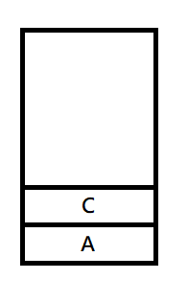
9. Assume the string of "ABCDEF" are sequentially pushed into a stack where elements in the stack can be popped during the period of pushing the letters. The state of the stack is shown as below and the next char is ‘F’. What is the possible outcome of the stack permutation? (3%)
Ans: bdefca bdecfa bdecaf
bedfca bedcfa bedcaf

Slide 11
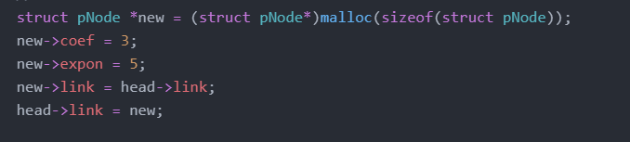
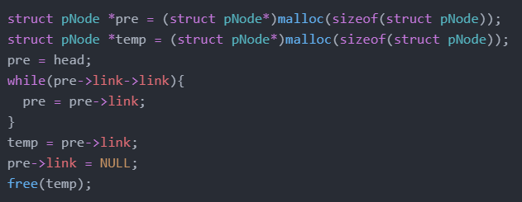
10.
(a) Insert 3x⁵ between 2x⁷ and 9x⁰.
(b) Delete the tail of the linked list.

Slide 12
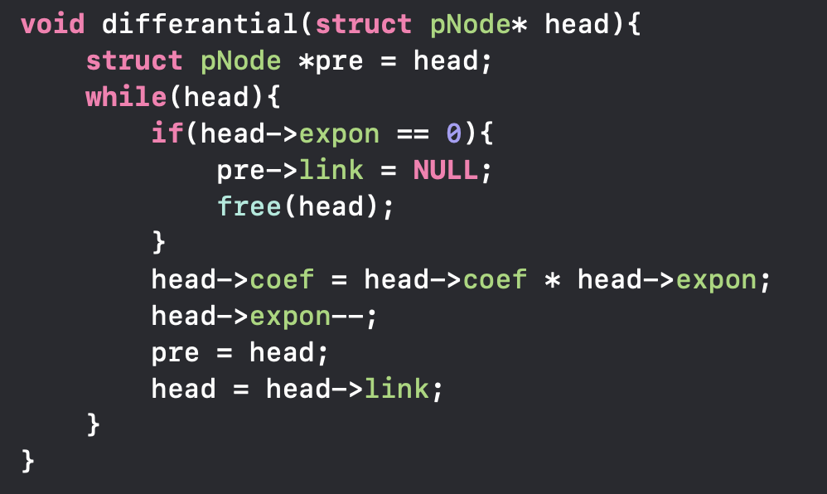
10.
(c) Finish a function that differentiates the polynomial function.

Slide 13
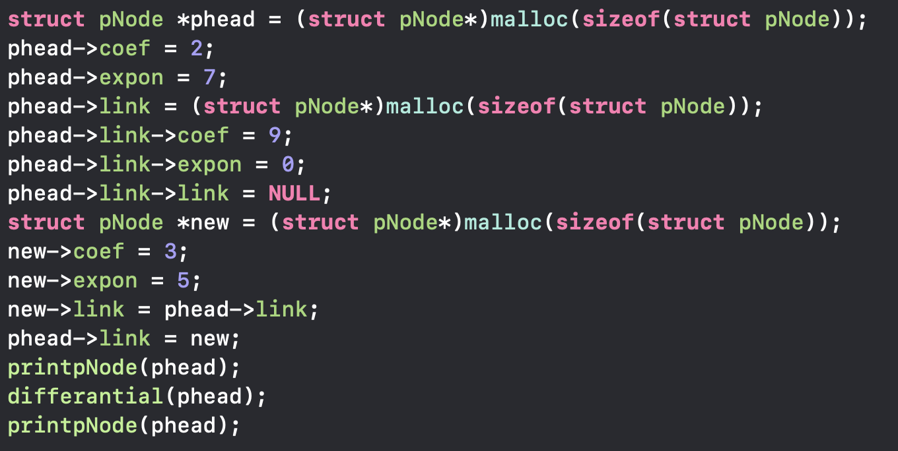
10. Main function

Slide 14
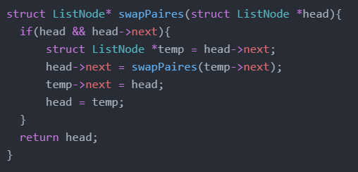
11.Given a linked list, swap every two adjacent nodes and return its head. (10%)
※You cannot modify the values in the list's nodes.
Head
A
B
2
3
4
5
6
Head
1
A
B

Slide 15
12.
int main(){
int mark[4] = {9,5,2,7};
int a = 50;
int *b = a;
int *c = &a;
int *d[4];
int (*e)[4] = mark;
int **f = e;
d[0] = d;
d[1] = b;
d[2] = c;
printf("mark’s position: %d\n", &mark);
printf("a1:%d, a2:%d\n", a, &a+10);
printf("b1:%d, b2:%d\n", b, &b);
printf("c1:%d, c2:%d\n", c, &c);
printf("d1:%d, d2:%d, d3:%d, d4:%d\n", *d[0], &d[1], d[2], &d);
printf("e1:%d, e2:%d\n", e[2], &e);
printf("f1:%d, f2:%d\n", *f+2, &f);
return 0;
}
(b) d2指向c, c指向a所以答案為a的位置
(c)為d的位置跟*d[0]一樣意思
(d) e為指向一個有4個int的array
其size = 4*4 = 16,
故e[2]為第三個(從0數)的array,
5000(第1個的位置) + 2*16 = 5032
(e) f指向 一個指向int的指標, *f=9 + 2*4 = 17
Output:
mark’s position: 5000
a1:50, a2:4000
b1: (a) , b2:3000
c1: (b) , c2:2000
d1:1000, d2:1008, d3: (b) , d4: (c)
e1: (d) , e2:500
f1: (e) , f2:250
Ans: (a) 50 (b) 3960 (c) 1000 (d) 5032 (e) 17

Slide 16
12.
(D)
e
(=mark=5000)
4*4 = 16
e[1]
e[2]

Slide 17
常見程式錯誤
沒有看好題目的function需要的return&parameter。
將malloc assign 給 struct，malloc只能assign給pointer.
LinkList的tail沒有接地(assign NULL)。

Slide 18
1102更新
由於c只有call by value，上次說的移動head位置(ex. head = head->next)並不會更改原本引數指標所指向的位置。
在傳入function時，系統會新增一份指標，並複製引數的位址給他。
head(in differantial function) 指向50,本身的位址為150
head(in main function)
假設head指向50,head本身的位址為100
Address: 50

Slide 19
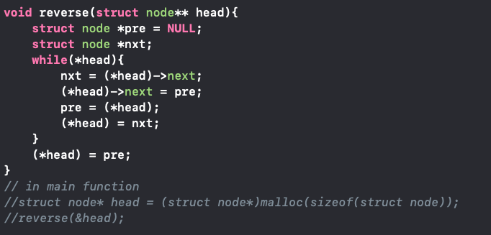
1102更新
若要更改傳入的指標指向的struct，則需要用指標的指標。
以反轉linklist為例。
head(in revserse function) 指向100
head(in main function)
假設head指向50,head本身的位址為100
在reverse function裡的(*head)即為main function裡的head
因此在revserse function裡對(*head)做操作會改變main function裡的指向
Address: 50

